Slide 1



Lisa Frazier
Senior Product Manager
Tyler Technologies

Slide 2

We envision a world in which no child grows up in an institution
“Science affirms what we know intuitively, that children belong in families.”
Dr. Dana Johnson, University of Minnesota

Slide 3

The Global Working Group was formed
Armenia
Benin
Bolivia
Brazil
Cambodia
Colombia
Dominican Republic
Ethiopia
Georgia
Ghana
Guatemala
Haiti
Honduras
Kazakhstan
Kyrgyzstan
Moldova
Nepal
Philippines
South Africa
Thailand
Togo
Uganda
Ukraine
United States
Zambia

Slide 4
What was identified as the greatest need?
A system to help track the children in care and place them with families.

Slide 5


Both Ends Believing & Tyler Technologies
A partnership to produce, distribute, and support the utilization of Children First software

Slide 6
















Profile
Plan
Placement
Monitoring
Government Agencies
Child Welfare Agencies
Care Providers
Adoption Agencies
State Department
Judiciary

Slide 7


Profile
The profile module provides a complete electronic record of the child, making the prior paper record digital and easily accessible
Plan

Slide 8
Profile
The planning module allows countries to build and manage a plan for each child, ultimately allowing the child to be either reunited with their birth family or placed with a new permanent family
Plan

Slide 9


The family profile module provides a complete electronic record of all available information on the prospective family hoping to care for a child
Family Profile

Slide 10


Placement
Profile
Profile
Plan
With all required, historical and relevant information from “both ends” fully digitized and electronically accessible, the placement module assists countries in determining the best family for each child
Government Agencies
Government Agencies
Child Welfare Agencies
State Department
Care Providers
Adoption Agencies
Judiciary
Judiciary

Slide 11
Placement
Profile
Family Profile
Plan
Monitoring
The monitoring module allows for streamlined post-placement reporting between agencies and countries, ultimately providing data for analytics to refine and improve outcomes for children

Slide 12



CFS: What’s new in 2019?
Family Registry, Placement, Monitoring modules
Reports for Routine Monitoring Indicators for Alternative Care
Government Officer, Government Supervisor roles
Profile mobile app with offline capabilities
Various enhancements

Slide 13
Current Status of CFS Implementation
In Production
Implementing
Evaluating
Global Working Group

Slide 14

Children First Software (CFS) in Uganda
Enabling the Ministry of Gender, Labor and Social Development (MGLSD)
Licensed for $1, “evergreen” model = no cost for quarterly releases, support, training
Hosted in a cloud environment
Limited access to data based on rights & roles
MGLSD IT Department responsible for configuration, training, in-country support
Equipping MGLSD with tools and techniques for implementation and support

Slide 15
Both Ends Believing and MGLSD History
Symposium #1
Harvard
Symposium #2
Los Angeles, CA
Symposium #3
Washington D.C.
2014
2015
2017
2016
2018
2019
2020
MOU Signed
Country Visit #1
Visit #2
Visit #3
CFS Profile v1
Pilot
CFS Profile
Expansion
CFS Planning
Pilot
CFS FR
Pilot

Slide 16
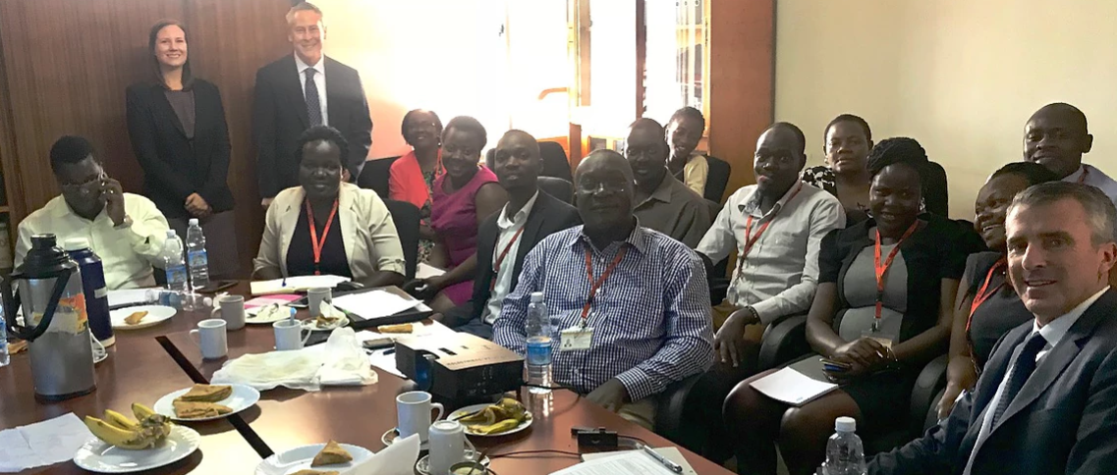
Children First Software Pilot
September – November 2018
4 NGOs + 1 GO participated
283 children registered
Key Outcomes:
Commitment to expand
New features identified
Development of reports to surface Routine Monitoring Indicators on children in Alternative Care.

Slide 17
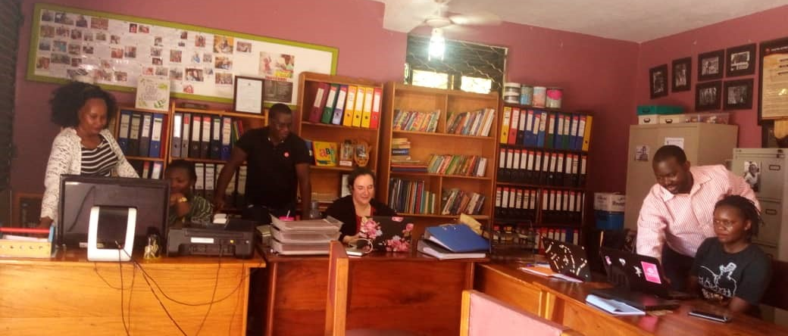
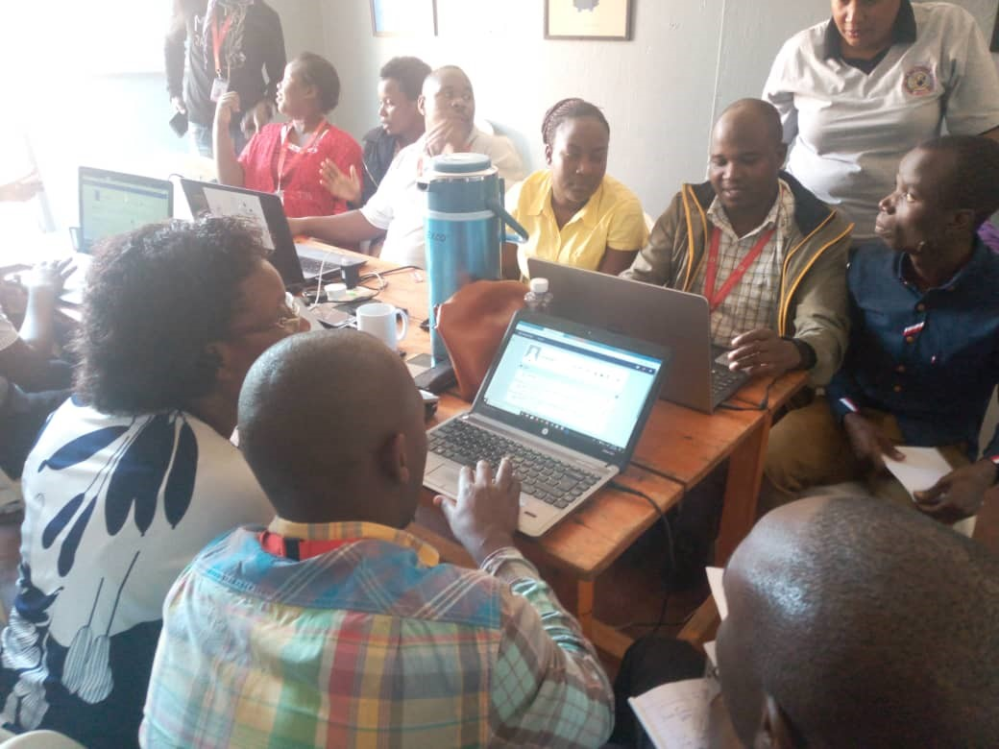
Phase 1 Results
July – September 2019
Focus Districts: KCCA and Wakiso
12 NGOs participated
- Day 1: Training
- Day 2+: Data entry
56 social workers trained
345 children registered

Slide 18
Children First Software Expansion Plan
Metric | # | %
Est. children homes | ~ 400
Licensed children homes | 106 | 100%
Licensed homes using CFS | 18 | 17%
Est. children in licensed homes | ~3180 | 100%
Children registered in CFS | 683 | 21%
Children with Plans | 24
Foster to Adopt | 7
Family Reunifications | 17
Where are we?
MGLSD commitment to implement CFS in licensed facilities
Roll out planned in 3 phases
Phase 2 begin: January 2020

Slide 19
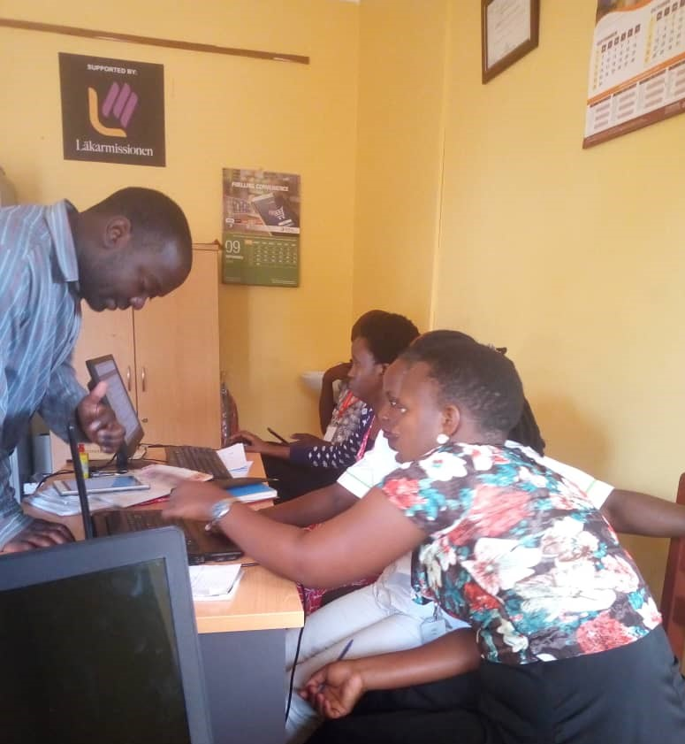
Lessons Learned
System is easy to use
Simplification of work due to organized records
Head of homes could access the information from their desk, confirming the social workers were doing their work
Promote sharing of experiences by creating a user group for homes using CFS

Slide 20
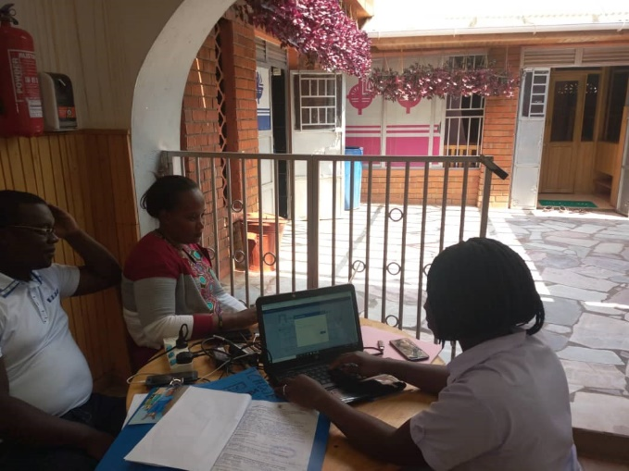
Lessons Learned
Homes need to plan for use of software
- Prioritize technology and equipment
- Hire / train staff with computer skills
MGLSD needs to send formal letter informing homes about the initiative ahead of training, conduct readiness assessment
Engage the Probation Social Welfare Officers (PSWOs) in the process

Slide 21

bothendsbelieving.org
@bothendsbelieving
Lisa Frazier
Lisa.Frazier@tylertech.com

